Slide 1

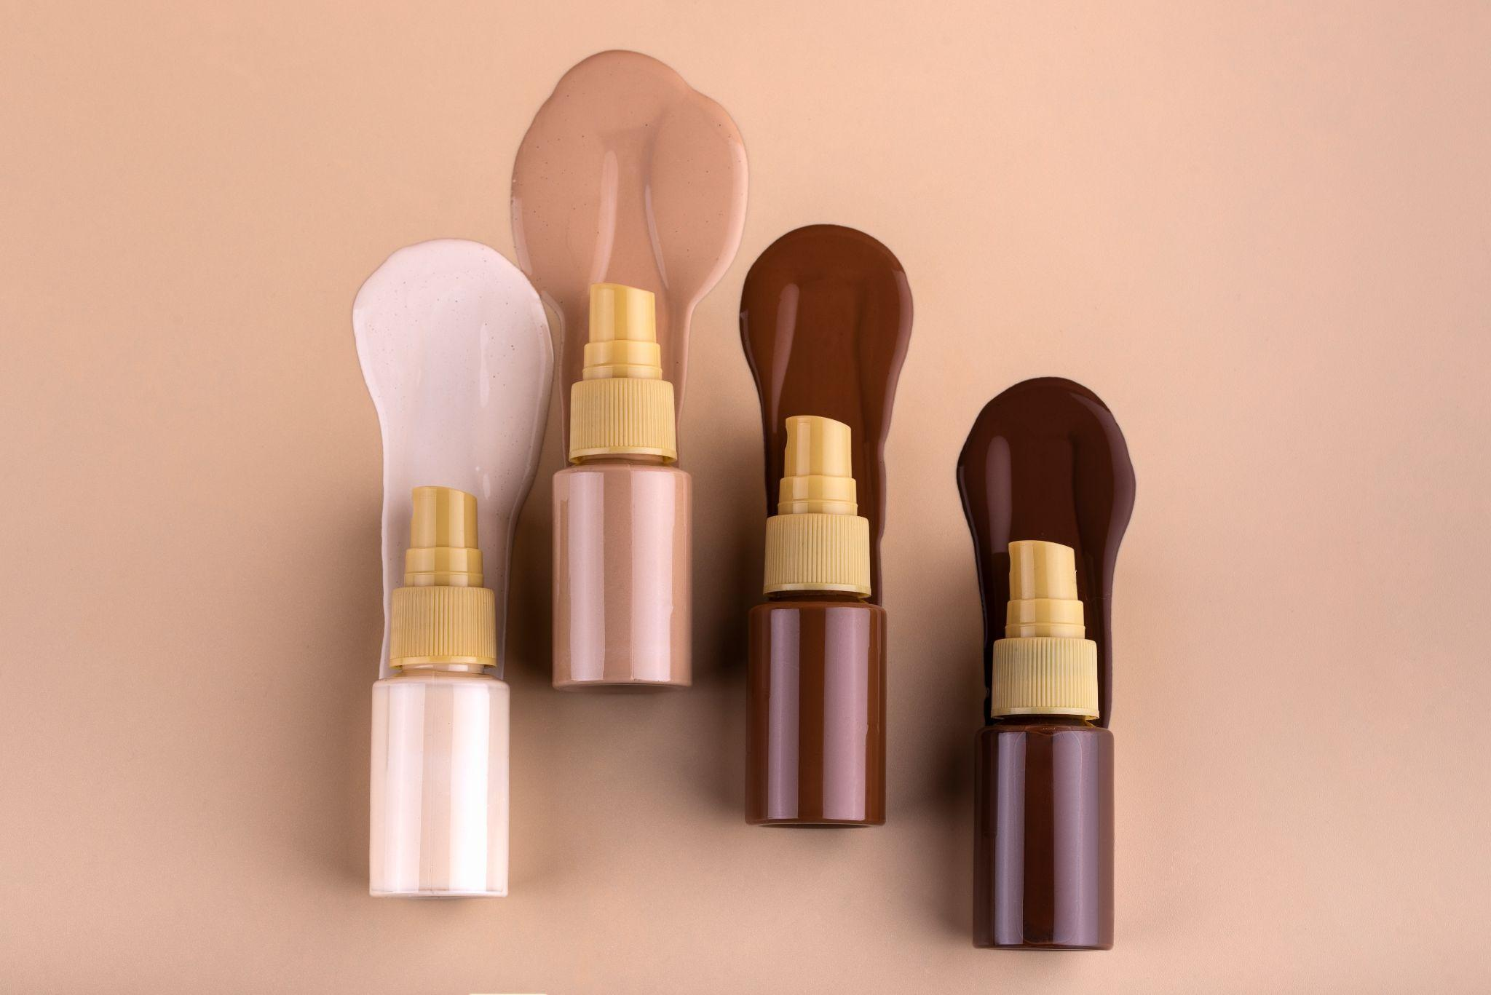
E-Commerce Cosmetics Store
1.
Project by
- TRILOK DHANEKULA
- DEEKSHITA CHITHAJHALLU

Slide 2
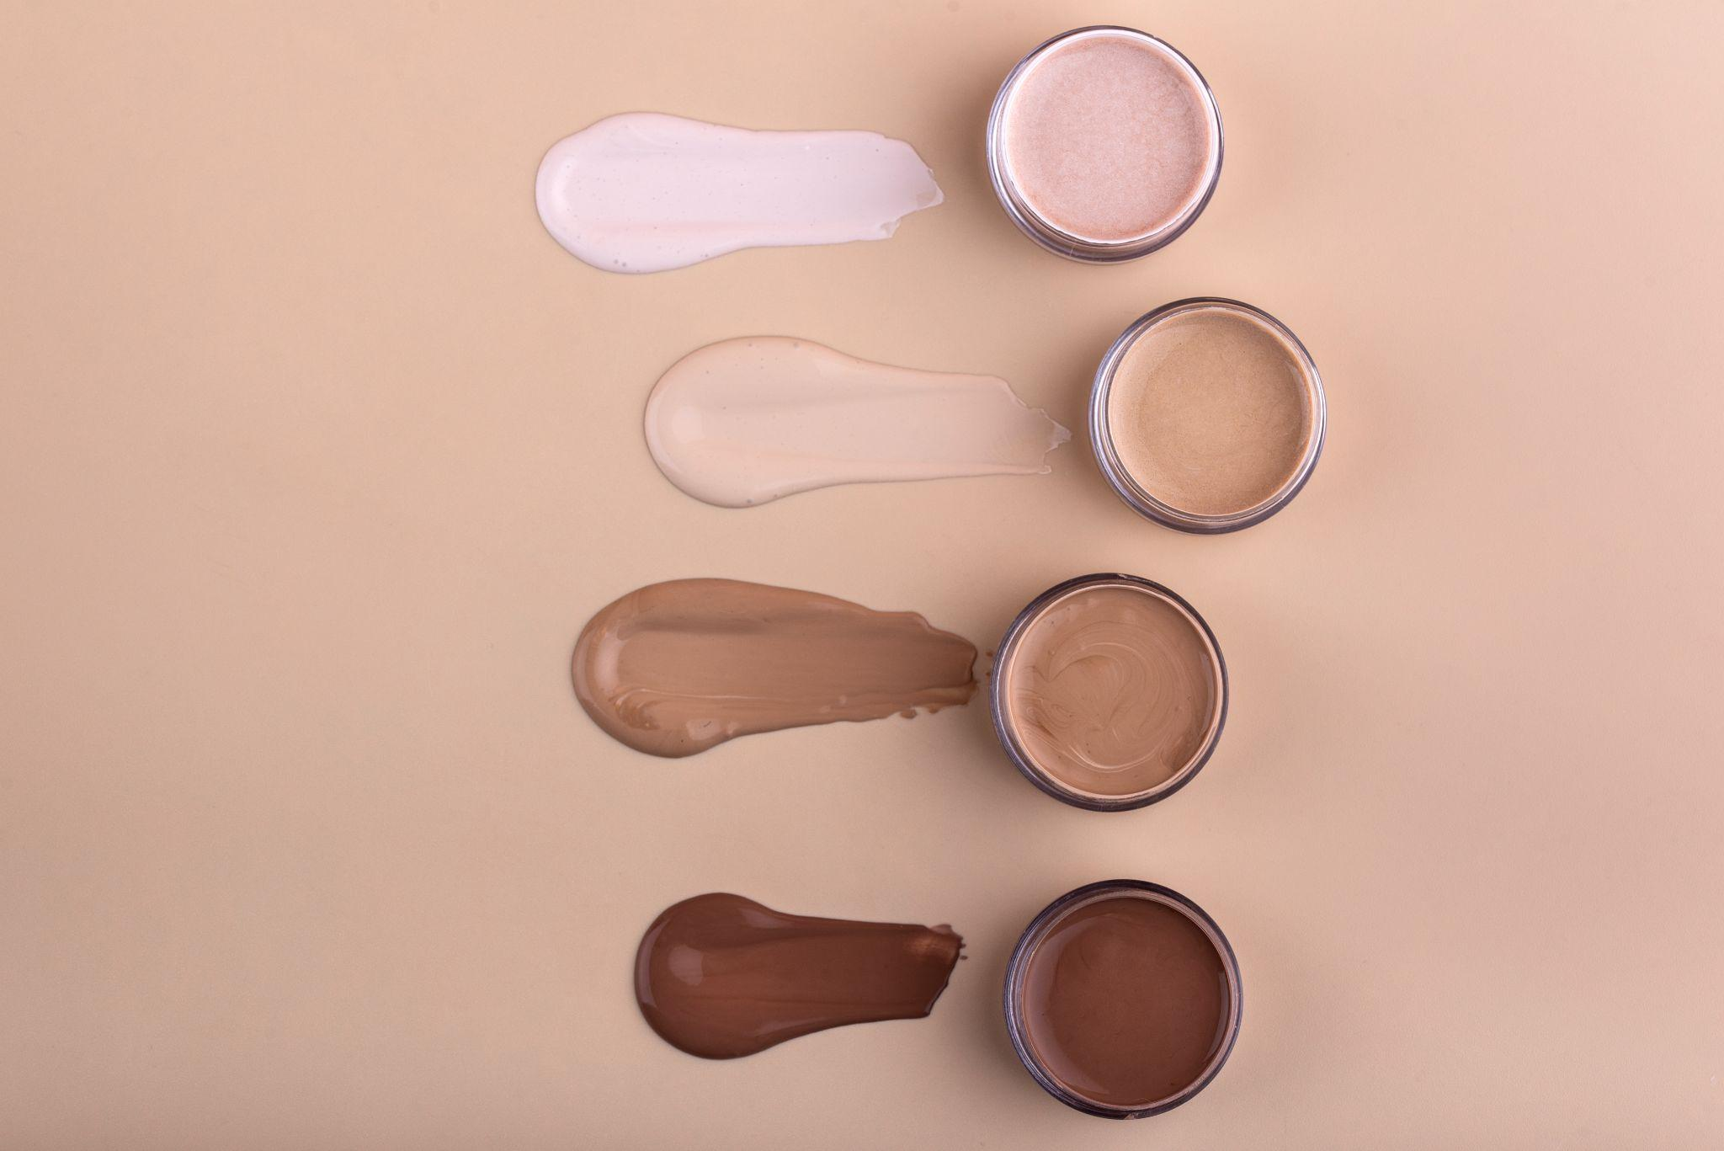
Table of contents
01
02
03
04
05
2.
Introduction
Business Question
Approach
Results
Conclusions

Slide 3


01
Introduction
3.

Slide 4

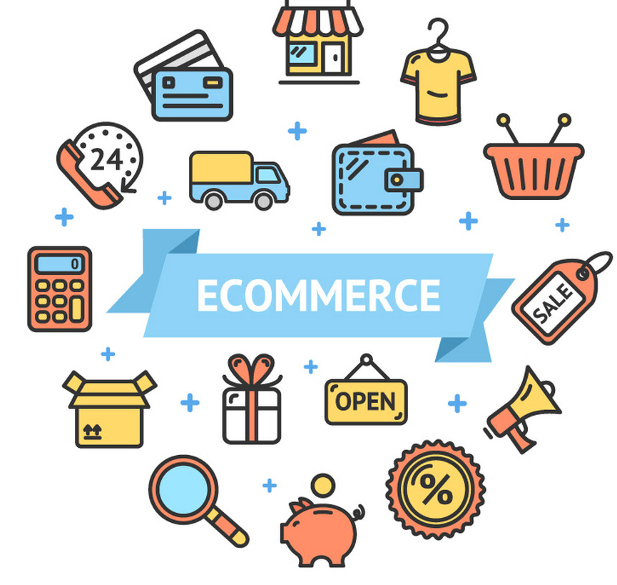

About E- Commerce website
4.
- The internet platforms known as e-commerce websites make it easier for people to buy and sell products and services online.
- They now play a crucial role in contemporary business, allowing companies to expand their customer base beyond conventional regional restrictions
Examples: The most famous Amazon is a leading
E-commerce website in the world.

Slide 5
About our Data.
5.
- We have a dataset on cosmetics E-Commerce website. The field of cosmetics has had a huge impact on almost every individual lately. Cosmetics are used for many different purposes not just for makeup.
- In our dataset, we can see that this website does call itself a cosmetics store but they do not just focus on cosmetics but have more to offer.
- this shows that the website has a lot of wide range of options for our consumers and to have many options in our catalog is always an advantage as people always prefer more options they can choose from

Slide 6
6.
Data Dictionary
Total number of observations: 3663737
Variables:
Event type cart : Chr: 0= Not in cart 1= In cart
Time of the day Morning: Chr 0,1
Time of the day Evening: Chr 0,1
Time of the day Afternoon: Chr 0,1
Product ID: Integer: 5773203 5773353 5881589 5723490 5881449 5857269 5739055
Category ID: num: 1487580005134238464 1487580005134238464 2151191071051219712
Category Code: Chr: Unknown, Appliances, Furniture, Stationary, Accessories
Brand: Num: 0= Unknown brand. 1: Known Brand
Price: Number
User ID: Integer: 463240011 463240011 429681830 463240011 429681830 430174032 377667011 467916806 385985999 474232307 ...
User Session: Chr: "26dd6e6e-4dac-4778-8d2c-92e149dab885" "26dd6e6e-4dac-4778-8d2c-92e149dab885" "49e8d843-adf3-428b-a2c3-fe8bc6a307c9" "26dd6e6e-4dac-4778-8d2c-92e149dab885" ...

Slide 7
Understanding the top factors that influence a customer to keep something in their cart.
7.
Our Business Question

Slide 8
APPROACH
8.
-Detecting the outliers and cleaning the data
-Creating new variables
For exploratory data analysis
Understanding the dataset.
- pre-processing the data
Performing Exploratory data analysis.
Evaluating the Performances and choosing the best model
- Conclusions/
Recommendations
- Choosing data mining methods
- Applying data mining methods

Slide 9
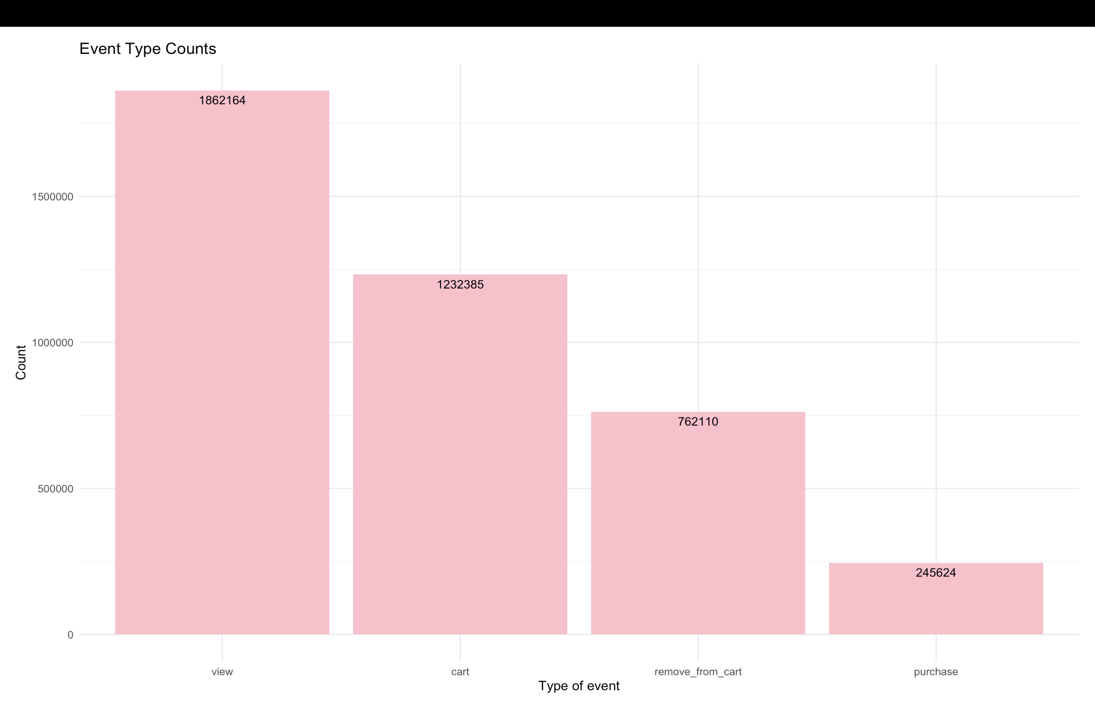
9.
These are the visuals of the data before cleaning the data

Slide 10
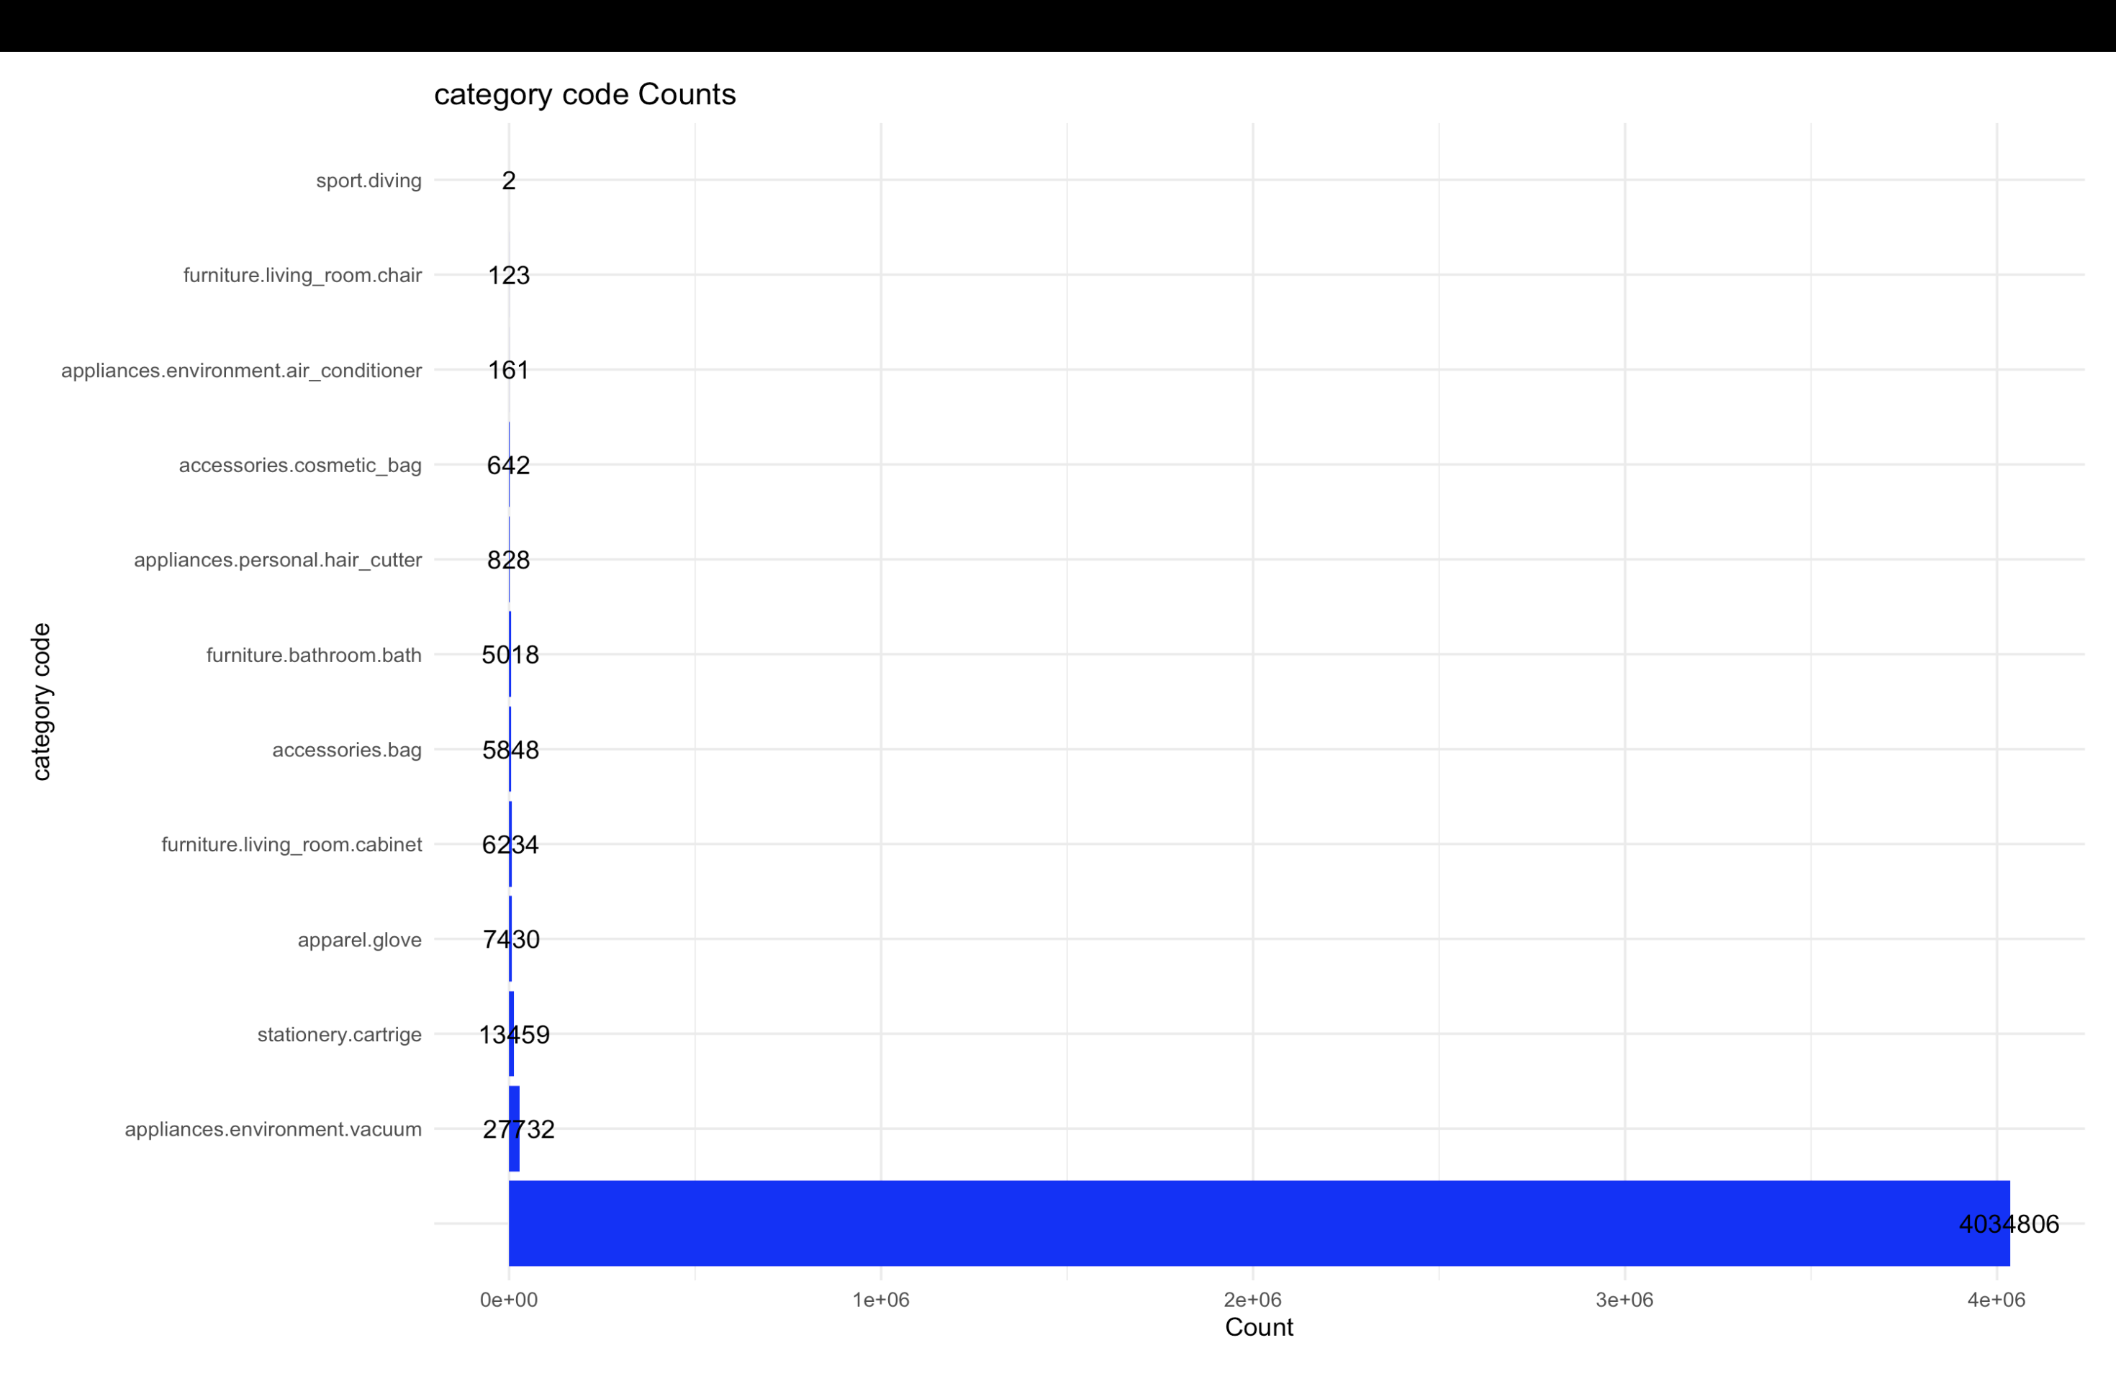
10.
These are the visuals of the data before cleaning the data

Slide 11
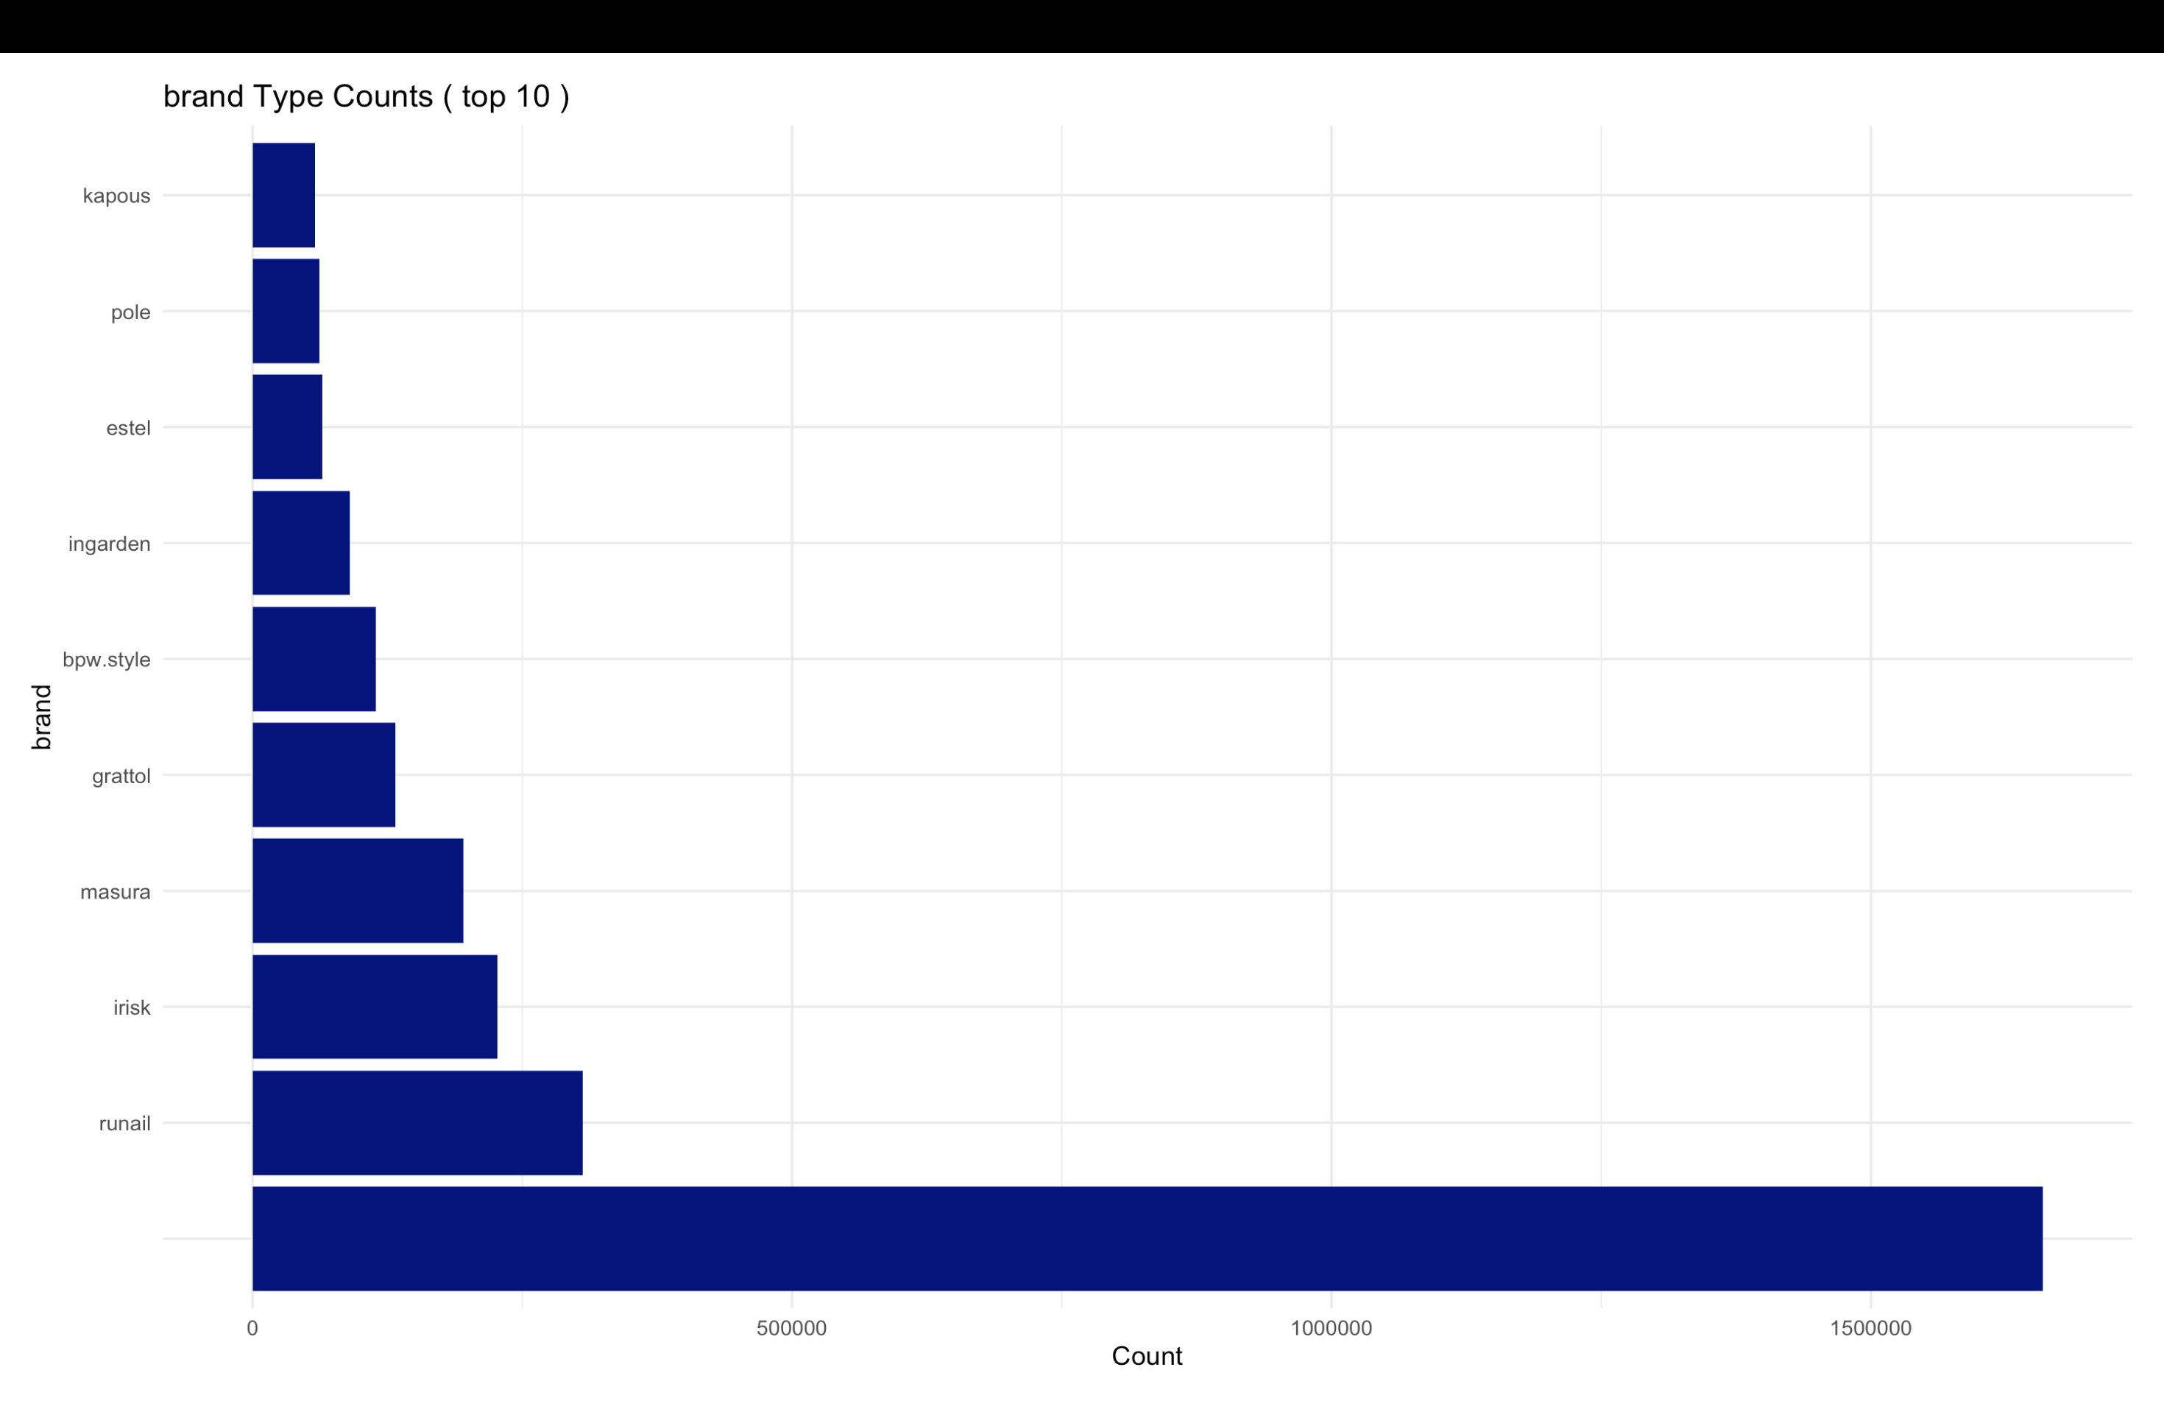
11.
These are the visuals of the data before cleaning the data

Slide 12
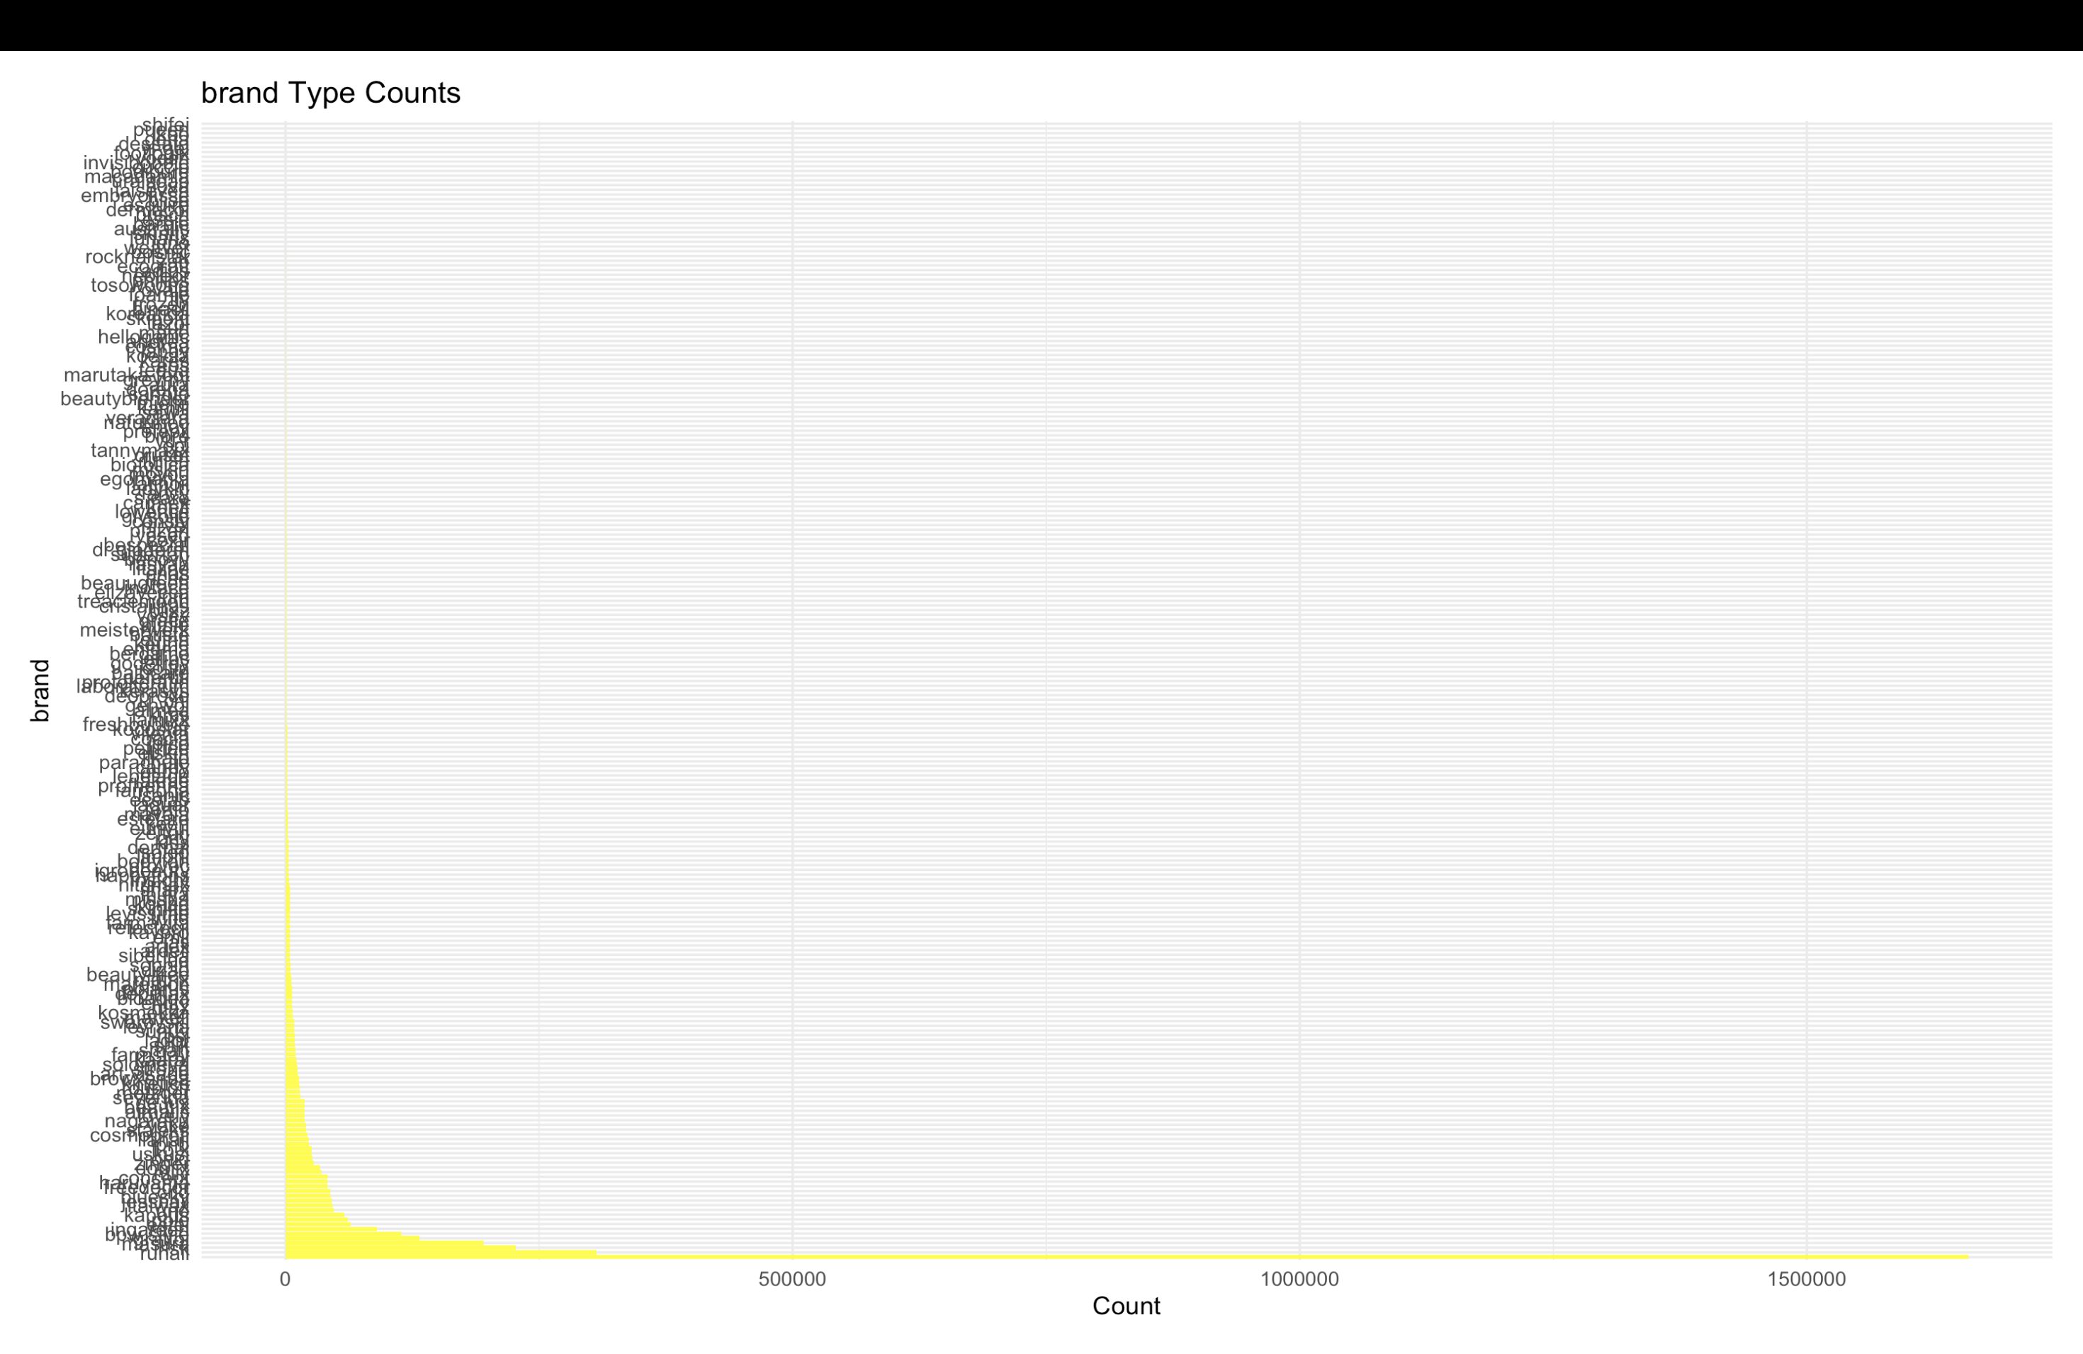
12.
These are the visuals of the data before cleaning the data

Slide 13
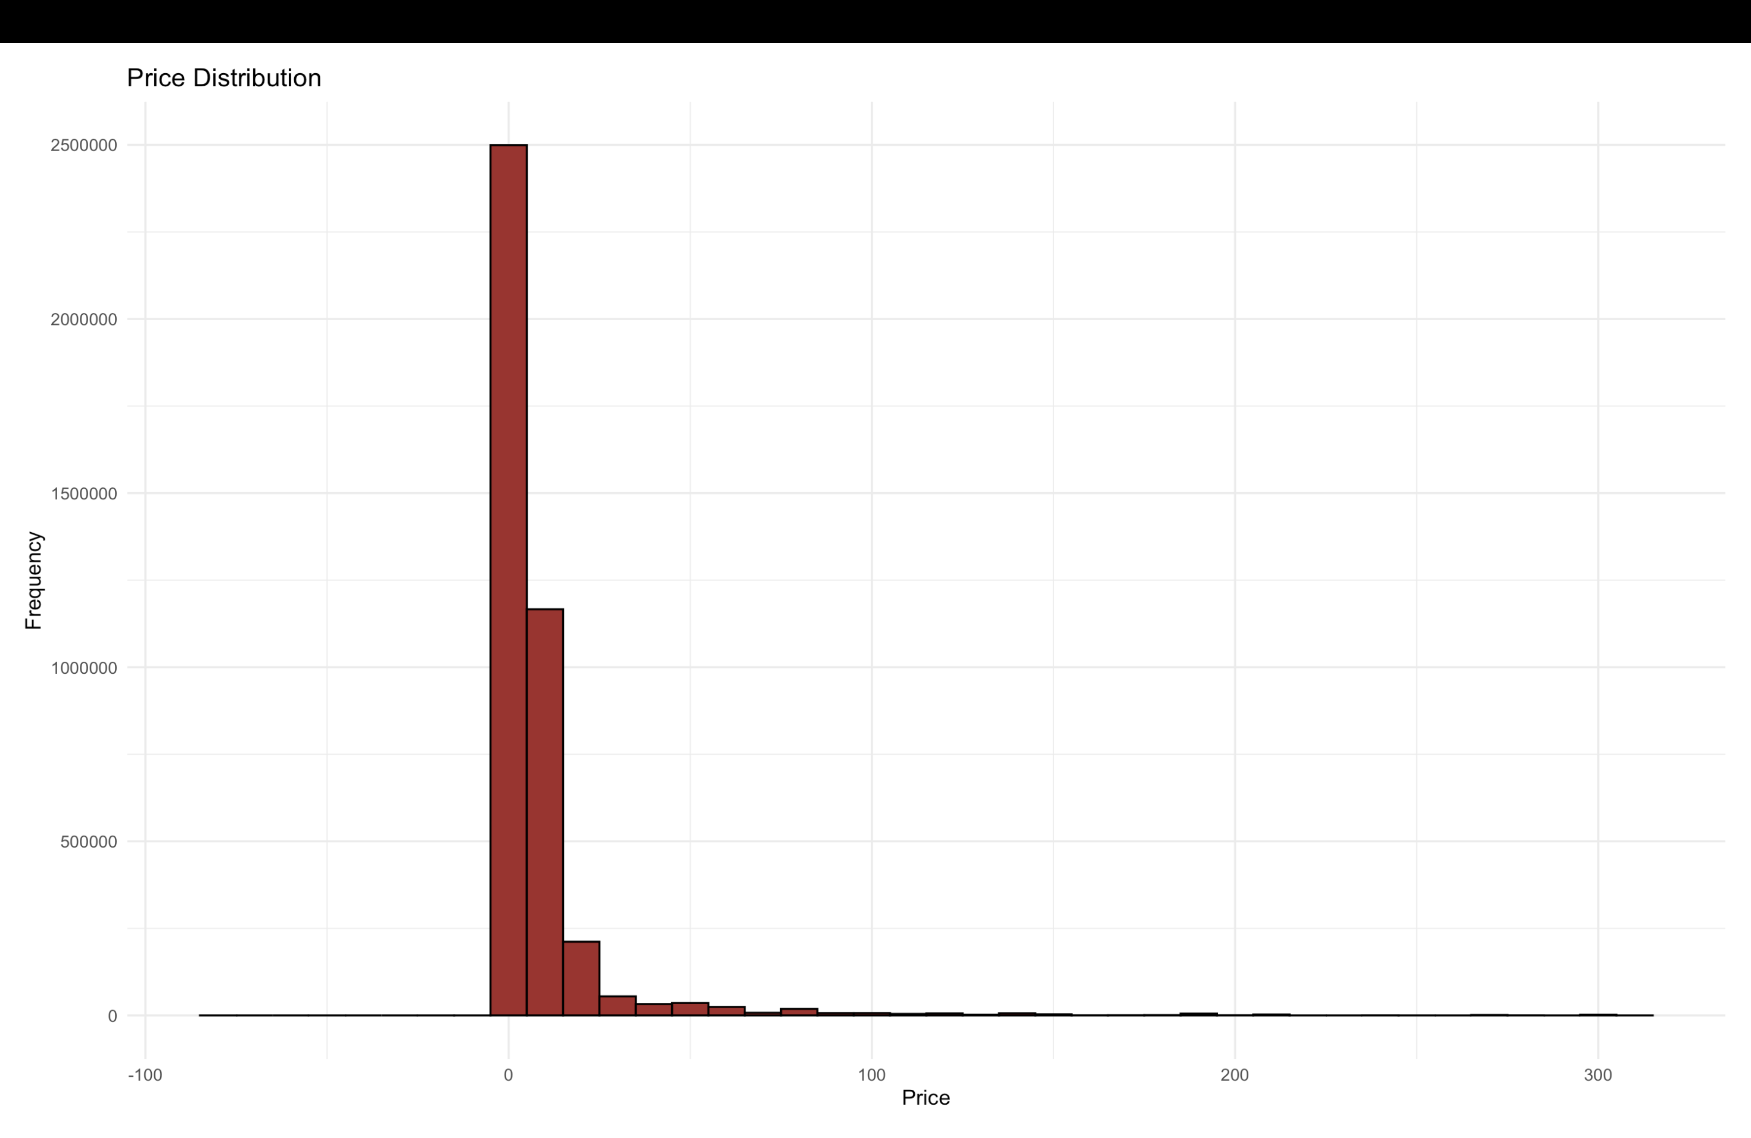
13.
These are the visuals of the data before cleaning the data

Slide 14
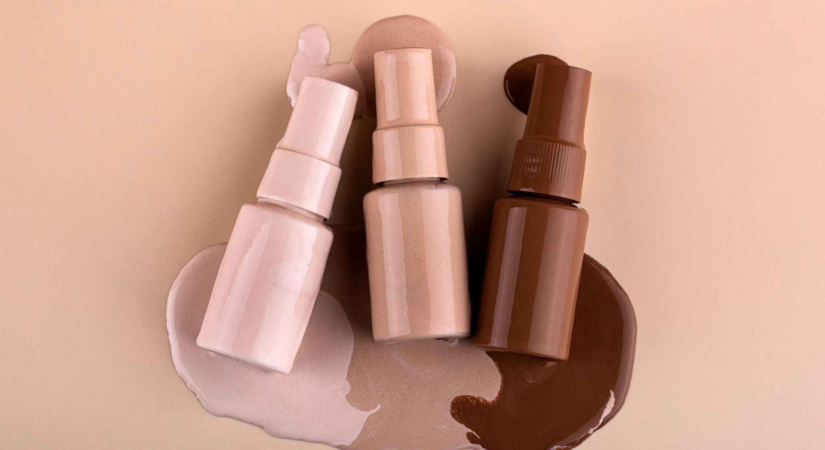
14.
Next, we will be seeing the new visuals that we got after removing outliers and cleaning the data.

Slide 15
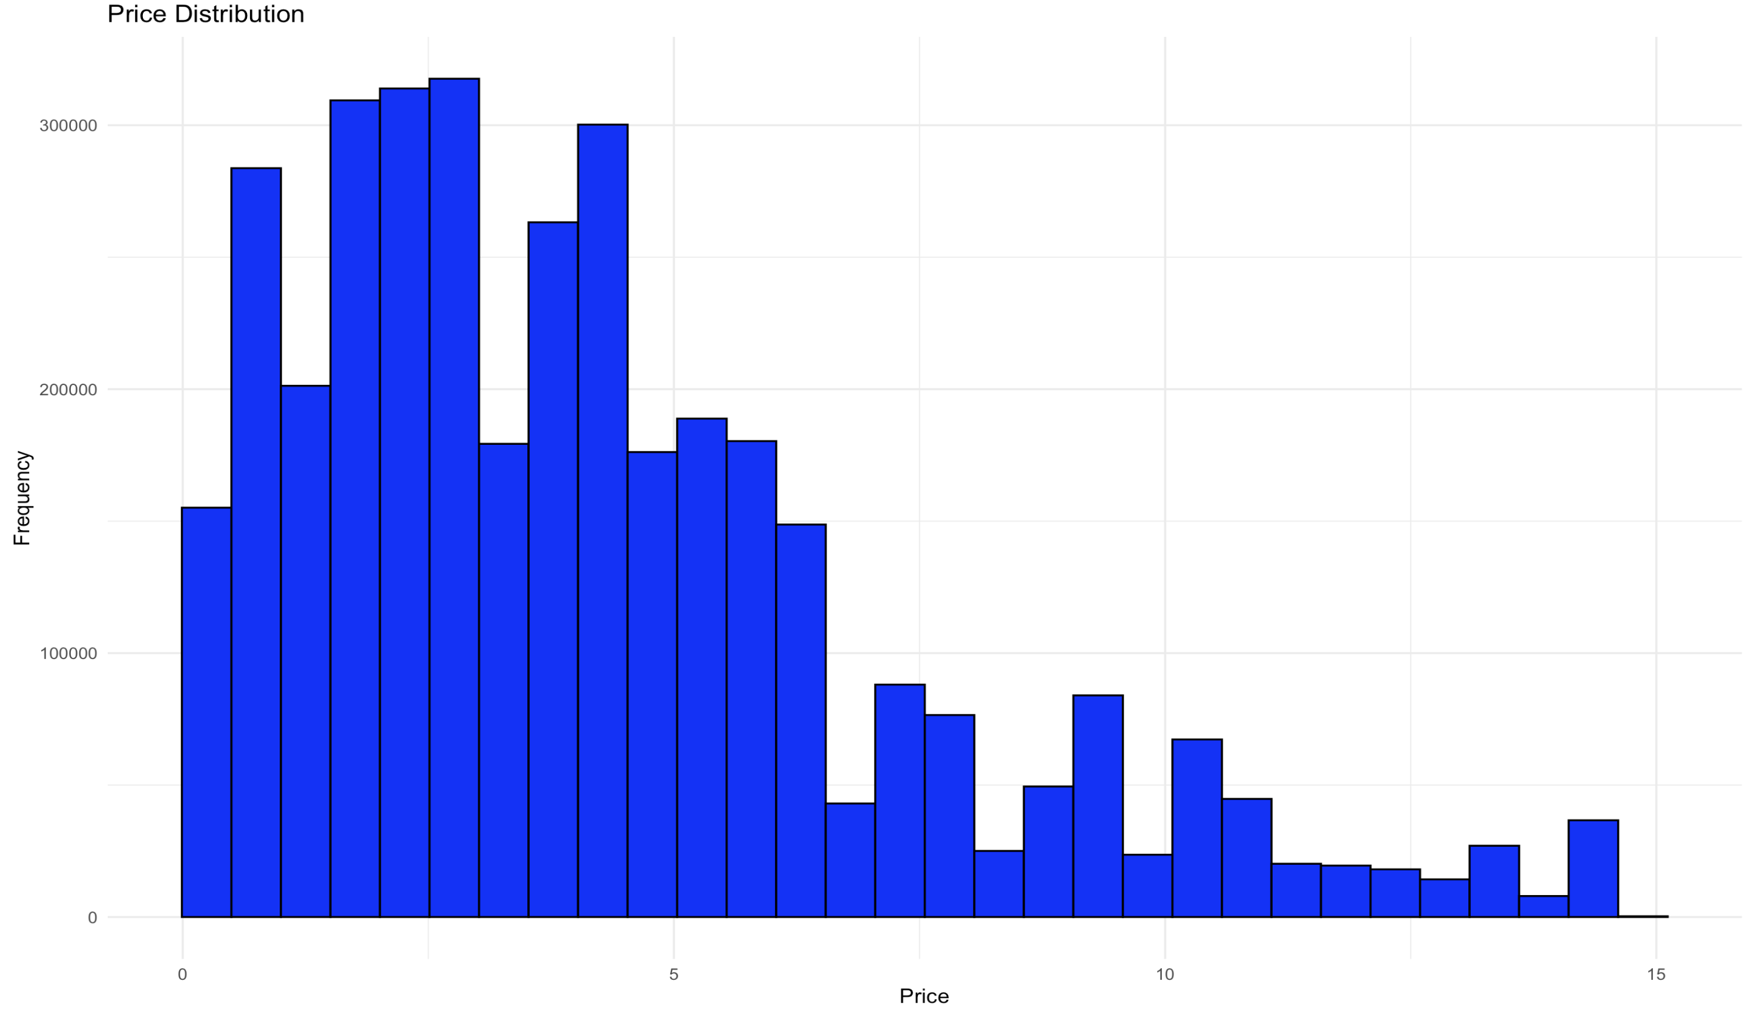
15.

Slide 16
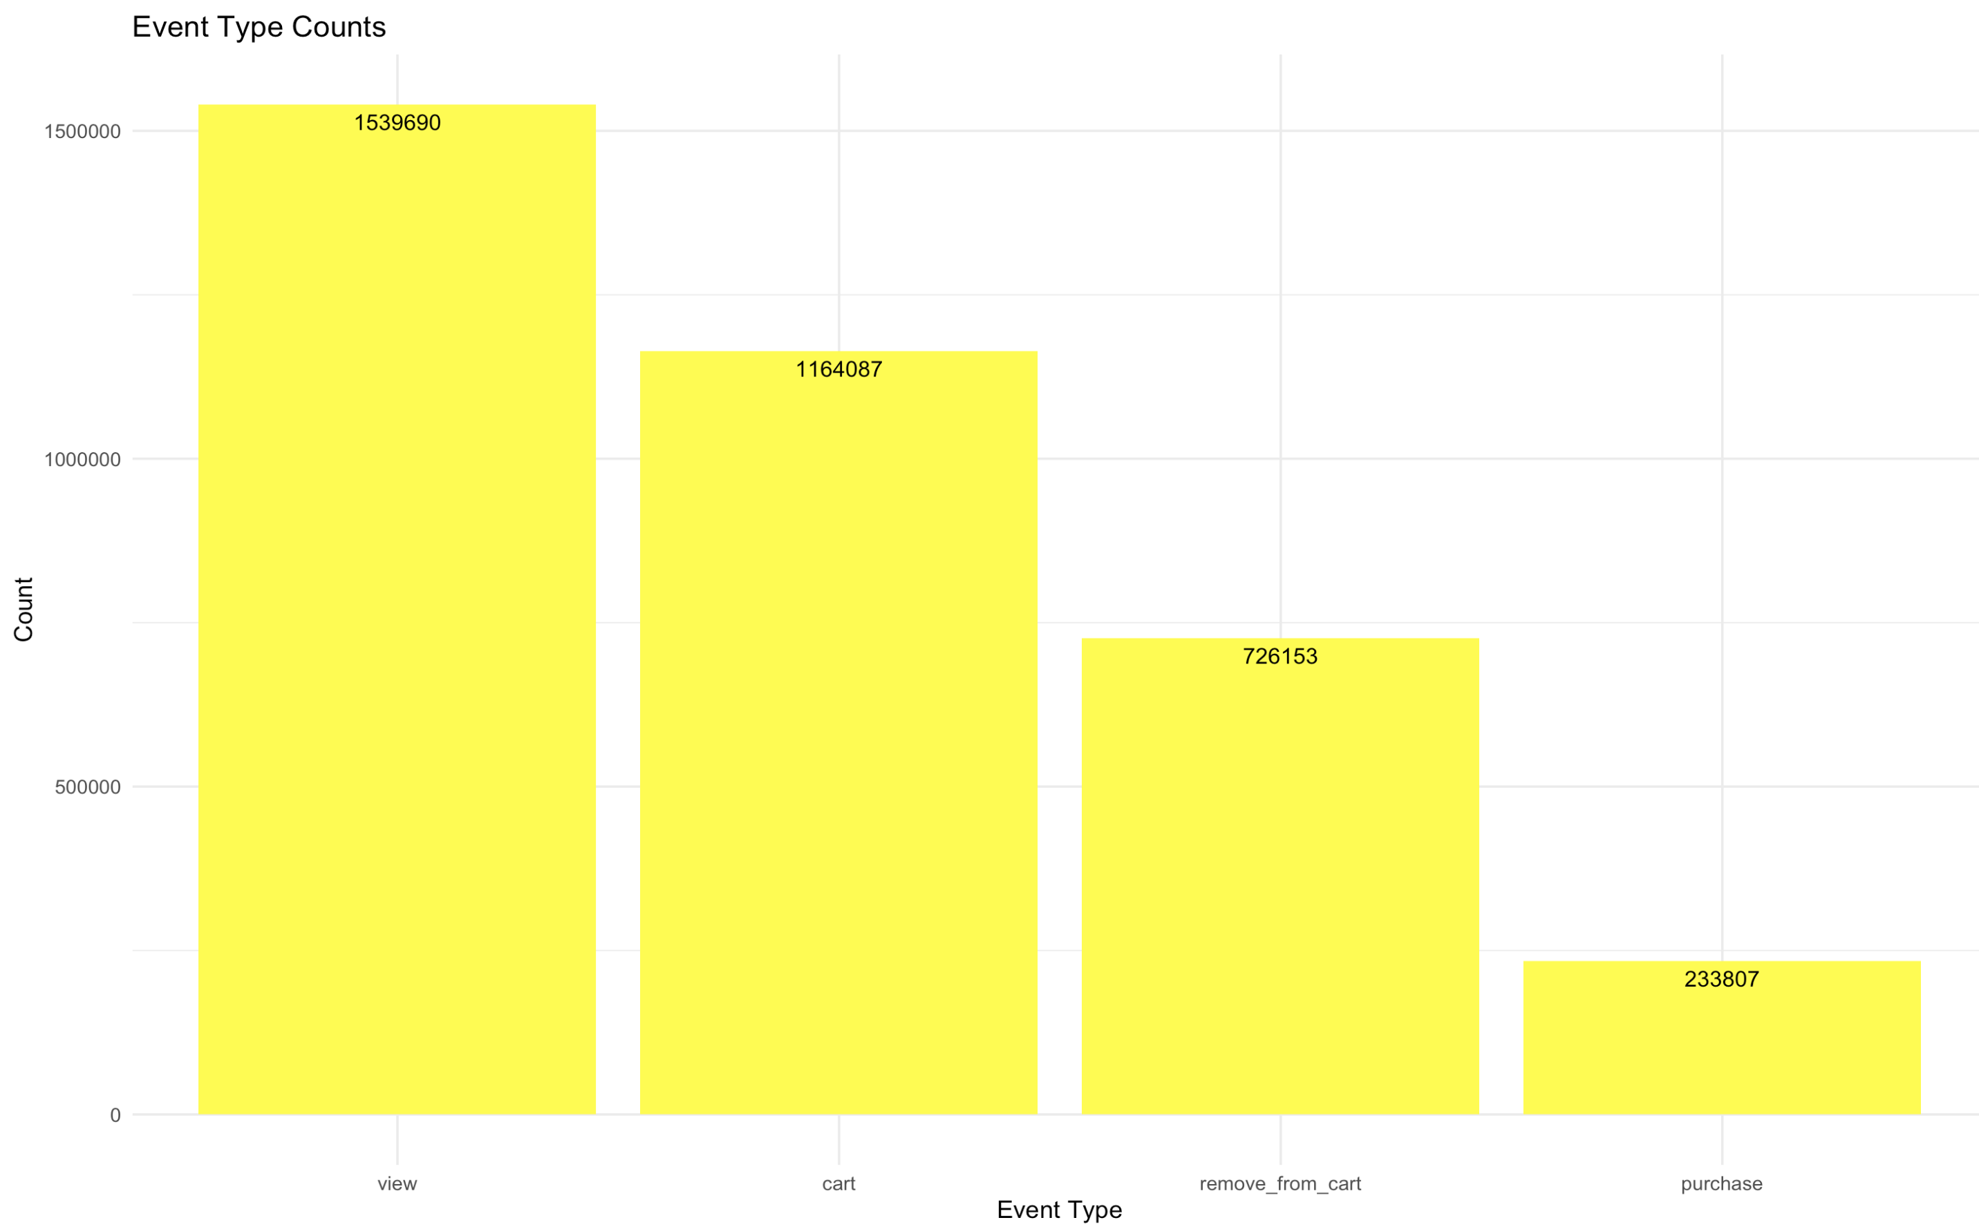
16.

Slide 17
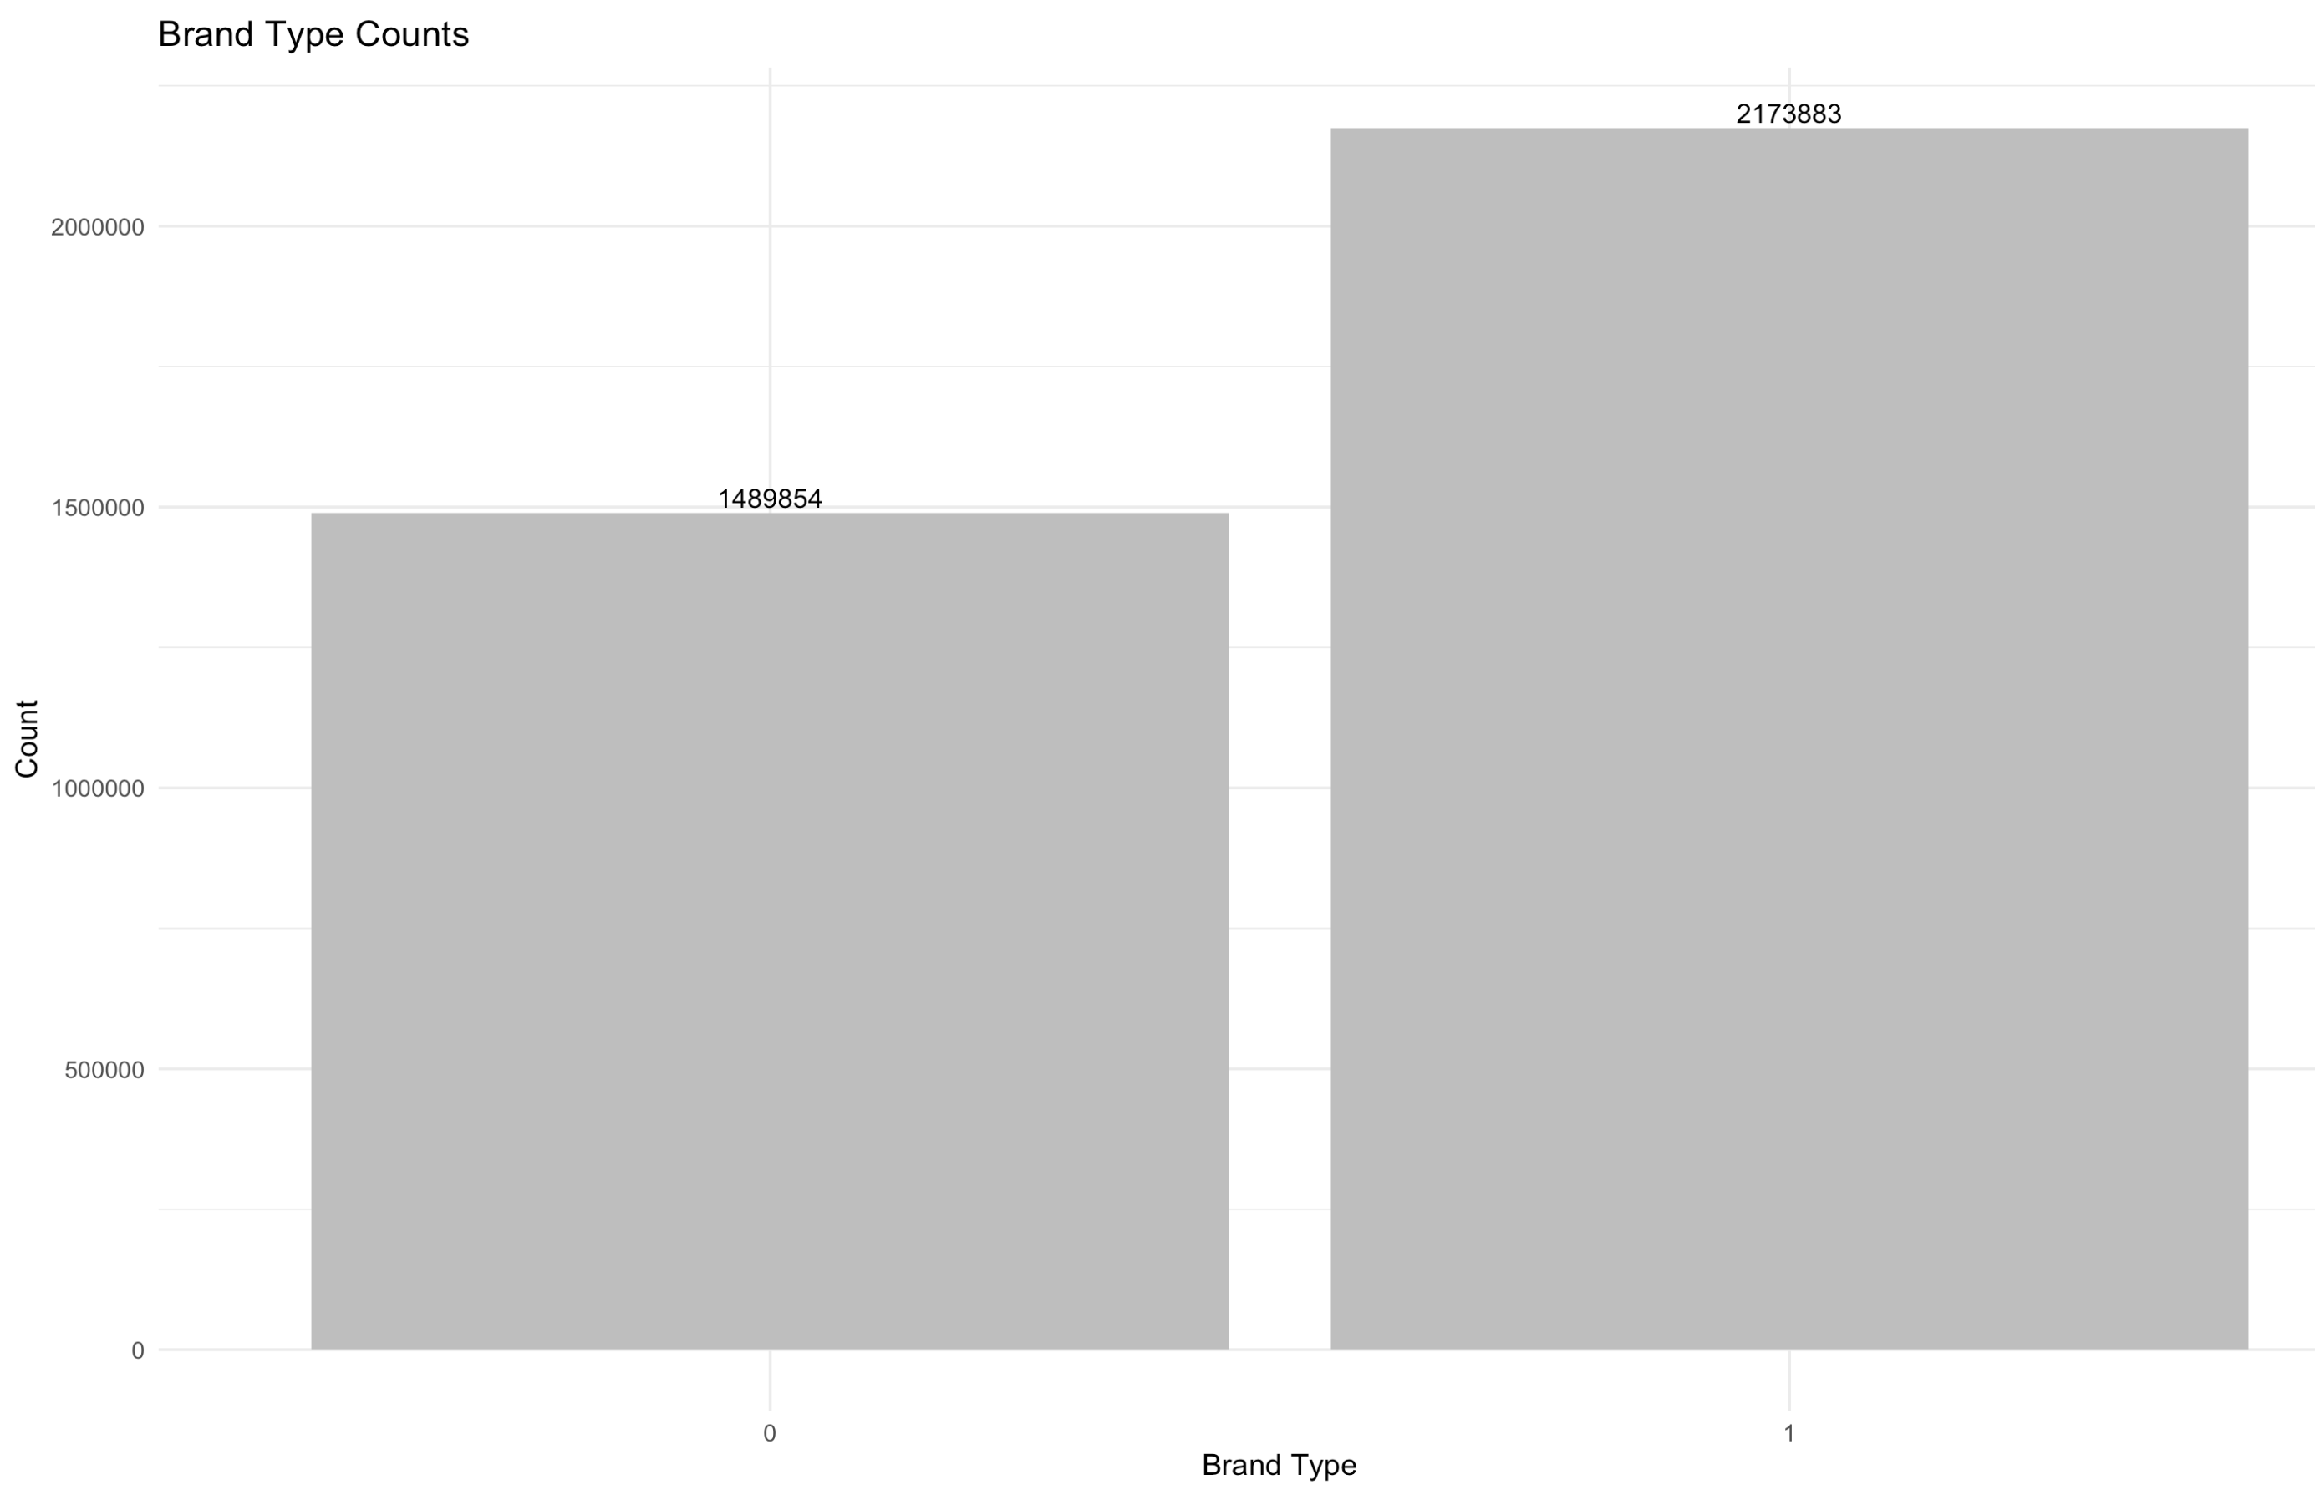
17.
The variable's Brand names have inappropriate values which are just blank. so for Brand, we have made it into a binary by making observations that have a brand name as 1 and no brand name as 0

Slide 18
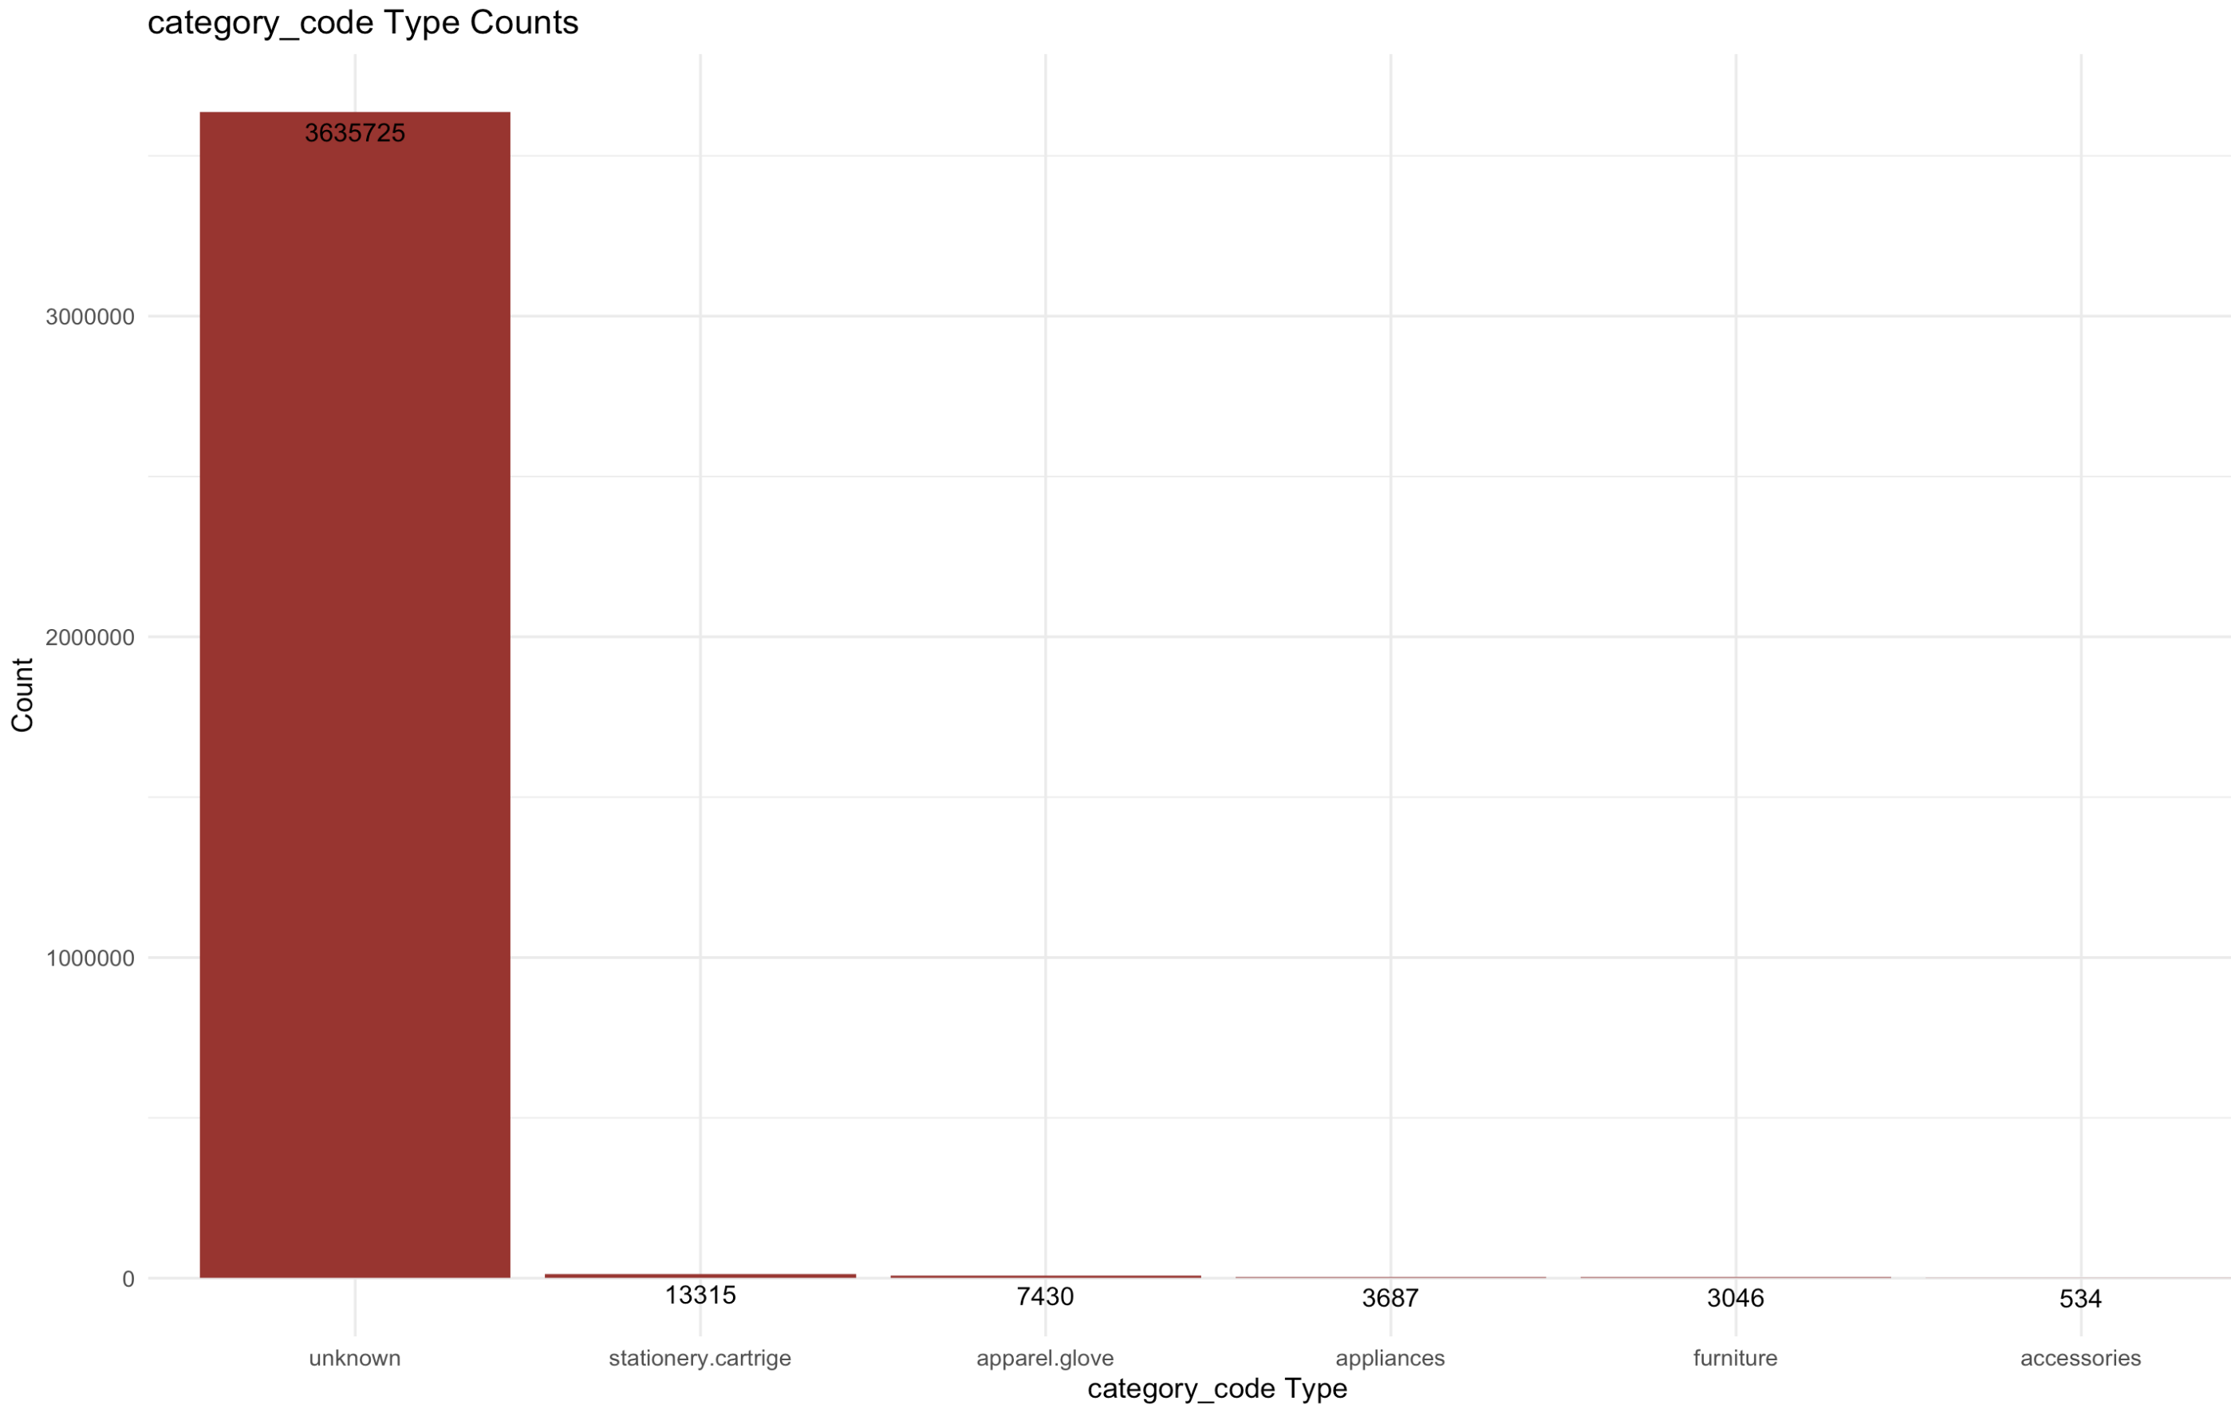
18.
The variable Category_code has inappropriate values which are just blank. for that reason, we are labeling brands into 5 main groups which are
Unknown
Furniture
Appliances
Accessories
Stationary

Slide 19
Creating new data variables:
19.
Event_Time
Morning
Afternoon
Evening
We have created 3 new variables from our Event_Time variable.
Because we had so many values we felt creating new ones would give a clear picture.

Slide 20
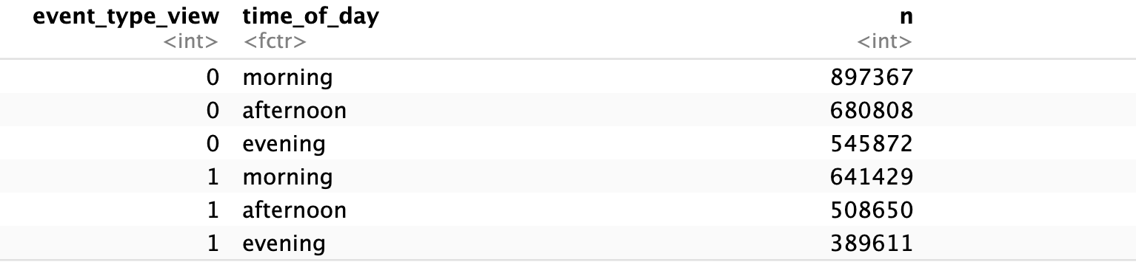
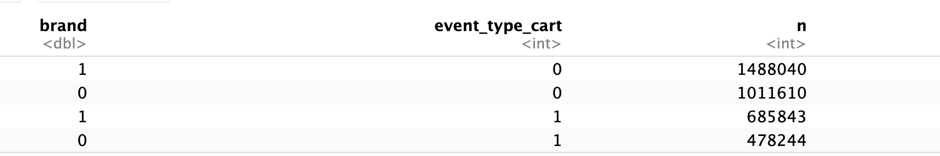
20.
Exploratory data analysis
Now let's see how our dependent variable Event_type_ cart is dealing with the variables
Time of the day Brand

Slide 21
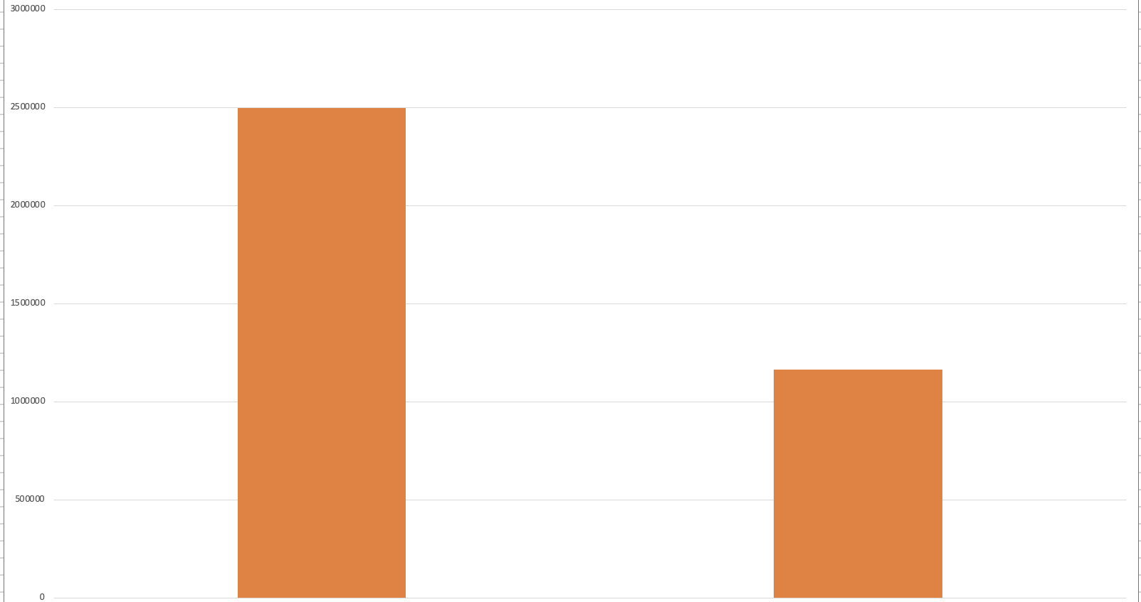
21.
Data before Balancing
Our dependent variable has 2 categories:
0= The person did not keep anything in their cart
1= The person kept something in their cart
Event Type cart
2499650
1164087
0
1

Slide 22
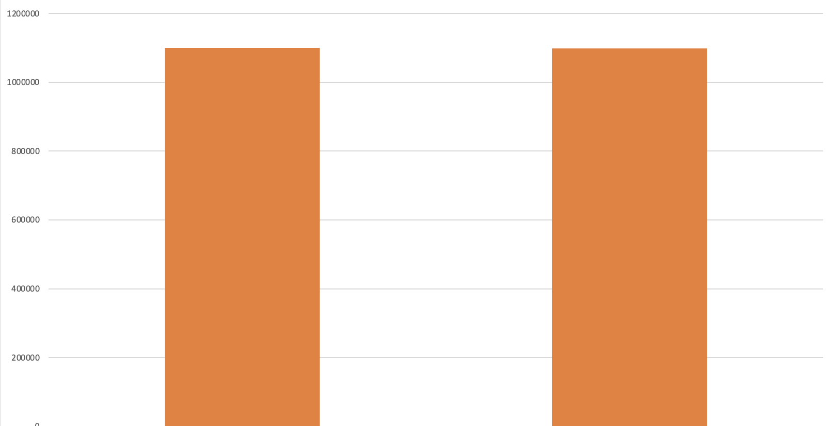
22.
Data after Balancing
it's an unbalanced dataset. and before we proceed with anything we need to balance it and for that
we will be using ROSE to balance the target variable.
The data generated from oversampling have the expected amount of repeated observations. ROSE helps us to generate data synthetically as well. The data generated using ROSE is considered to provide a better estimate of original data.
Event Type cart
1099699
1098544
1
0

Slide 23
Data Mining models
23.
Model | Accuracy | Sensitivity | Specificity
Logistic Regression | 0.525 | 0.494 | 0.591
Decision Tree | 0.6202 | 0.7472 | 0.3475
Logistic Regression Model Error Rate: 0.5
Decision Tree Model Error Rate: 0.4
Logistic Regression Model Accuracy Rate: 0.5
Decision Tree Model Accuracy Rate: 0.6

Slide 24
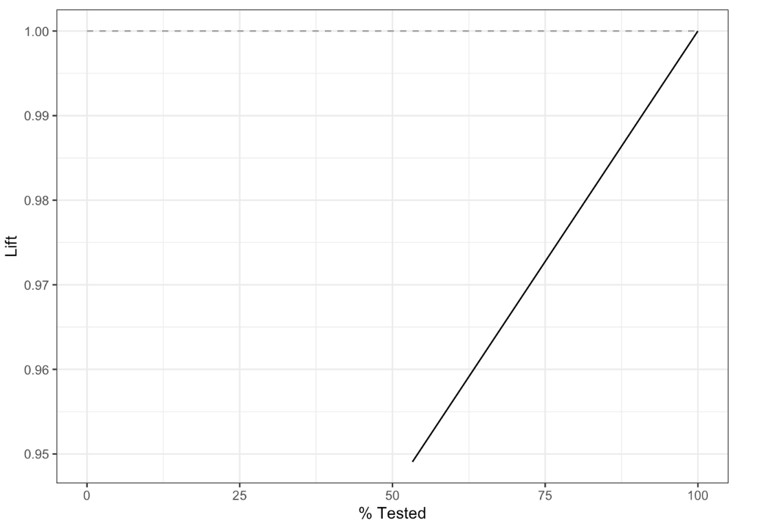
24.
Logistic Regression Lift Curve

Slide 25
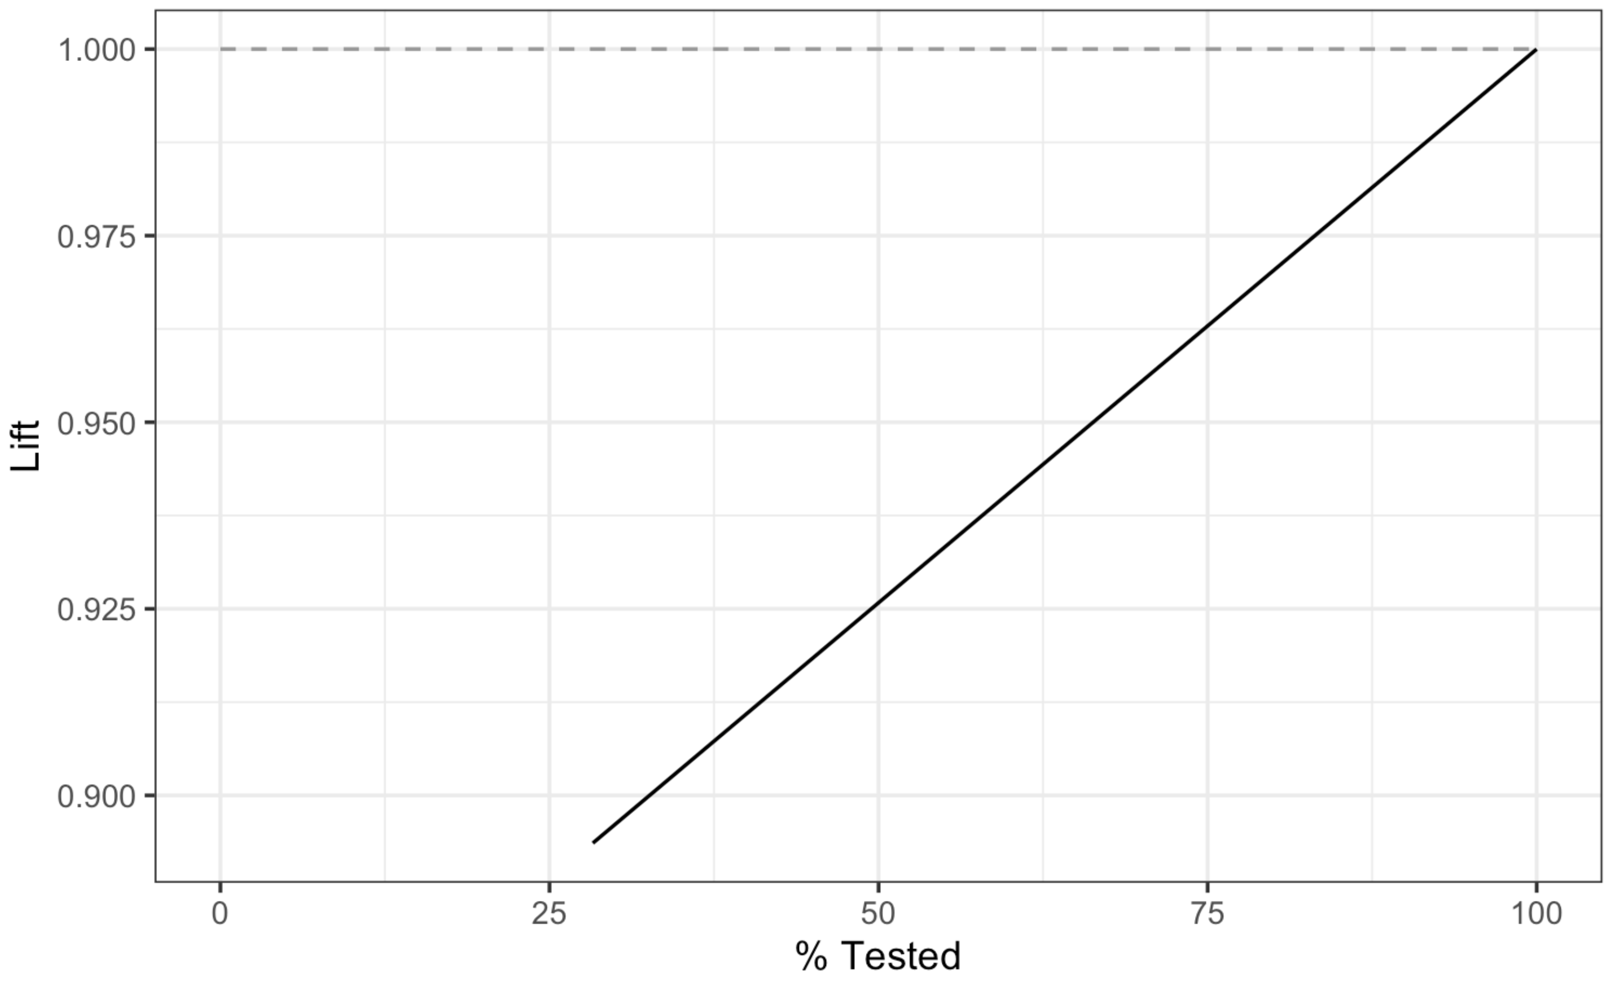
25.
Decision Tree Lift Curve

Slide 26
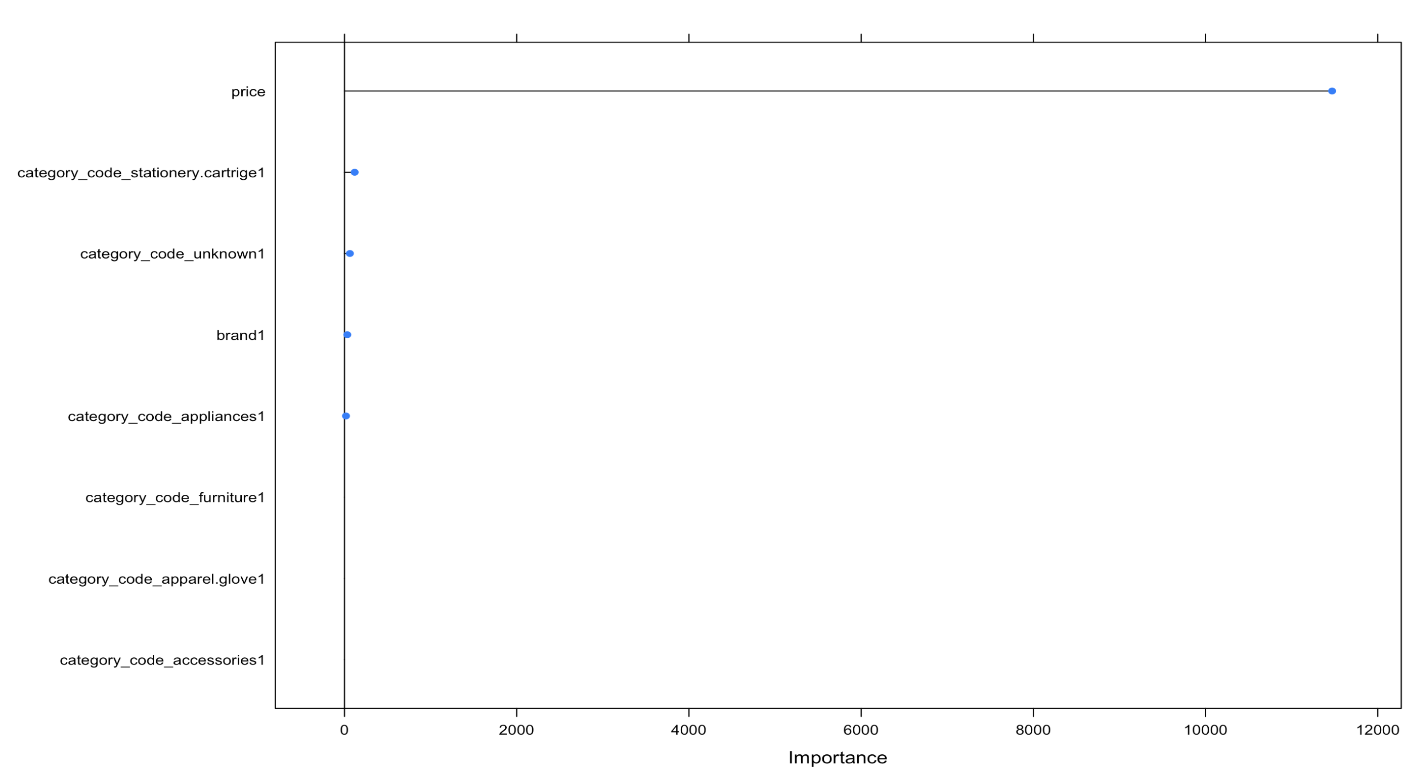
26.
Importance graph

Slide 27
27.
Conclusions:
- We can conclude that users are most affected by Price.
Recommendations:
- we would recommend by the results that the website should have a discount to the most frequent users.
- Having performed a customer lifetime value will give us how much we can expect from retaining a specific group of customers
- We have segmented the time of the day, using that we can see and understand at what point of the day the consumer visits the website and adds something in their cart.
-There are a lot of unknown brands so clustering them and having to group them would make it much easier to analyze.

Slide 28


Thanks!
Questions?

